Slide 1
L
E
Q
LONG
ESSAY
QUESTION

Slide 2
LEQ
THE LONG ESSAY QUESTION IS YOUR FINAL CHALLENGE ON MAY #. 40 MINUTES FOR 15% OF YOUR SCORE.

Slide 3
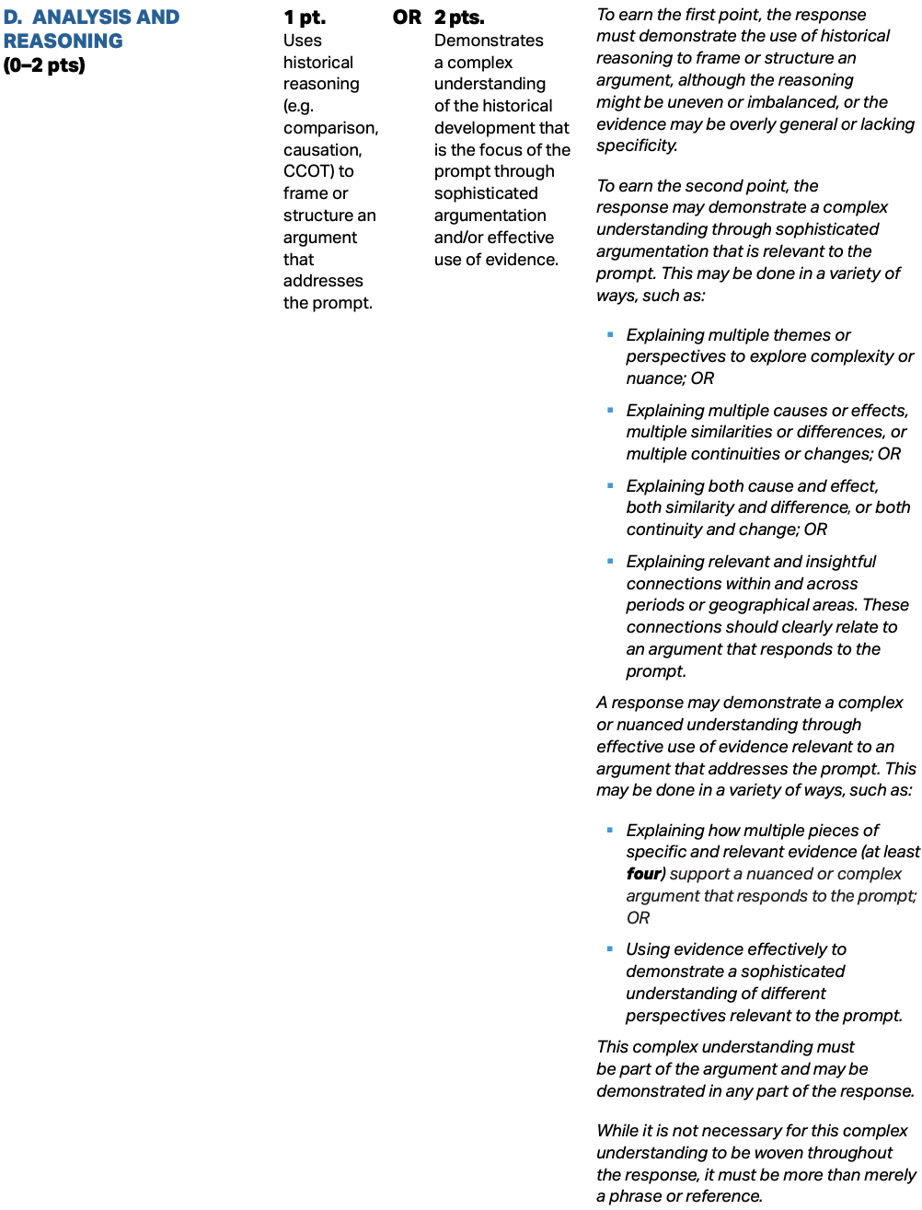
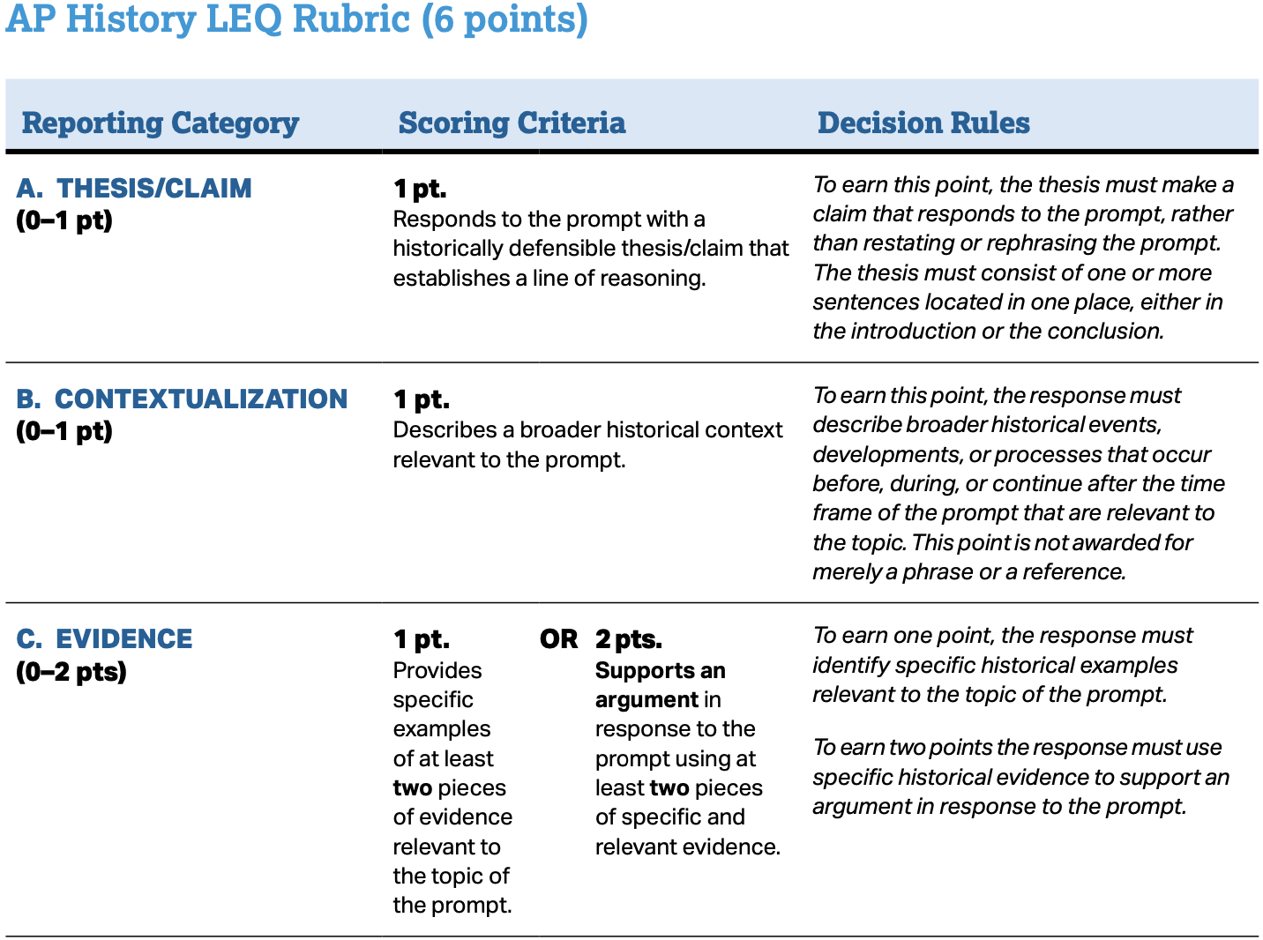
LEQ
NEW 2023 RUBRICS!

Slide 4
GOOD NEWS:
YOU WILL HAVE A CHOICE…
“STUDENTS WILL CHOOSE ONE OF TWO LONG ESSAYS TO ANSWER IN WRITING.”

Slide 5
BAD NEWS:
THERE ARE 4 OPTIONS…
“STUDENTS WILL ANALYZE AN ISSUE USING THE HISTORICAL THINKING SKILLS OF COMPARISON, CAUSATION, CONTINUITY & CHANGE, OR PERIODIZATION.”

Slide 6
HOW YOU ARE ASSESSED:
ALL FOUR ESSAYS ARE ASSESSED IN THE SAME MANNER WITH SLIGHT DIFFERENCES DEPENDING ON THE TYPE OF ESSAY BEING ASKED

Slide 7
LET’S WARM UP YOUR COMPARISON SKILLS… FIND AS MANY SIMILARITIES & DIFFERENCES IN THESE TWO PICTURES IN 5 MINUTES.

Slide 8
USING SPECIFIC EXAMPLES, ANALYZE THE SIMILARITIES & DIFFERENCES IN THE CAUSES OF THE GREAT WAR & WWII.
3 TOTAL (AT LEAST ONE OF EACH)
DIFFERENCES
SIMILARITIES
3 TOTAL (AT LEAST ONE OF EACH)
1. ______ 2. ______ 3. _______ 4. ______ 5. _______ 6. ______
HOW DOES EACH EVIDENCE SUBSTANTIATE THESIS (1-6)
1. ______ 2. ______ 3. _______ 4. ______ 5. _______ 6. ______

Slide 9
CAUSATION ASKS YOU TO LOOK AT THE CAUSES & EFFECTS OF SOMETHING. LIST 3 CAUSES & 3 EFFECTS OF THIS IMAGE…

Slide 10
CAUSATION ASKS YOU TO LOOK AT THE CAUSES & EFFECTS OF SOMETHING. LIST 3 CAUSES & 3 EFFECTS OF THIS IMAGE…

Slide 11
CAUSATION ASKS YOU TO LOOK AT THE CAUSES & EFFECTS OF SOMETHING. LIST 3 CAUSES & 3 EFFECTS OF THIS IMAGE…

Slide 12
CAUSATION ASKS YOU TO LOOK AT THE CAUSES & EFFECTS OF SOMETHING. LIST 3 CAUSES & 3 EFFECTS OF THIS IMAGE…

Slide 13
CAUSATION ASKS YOU TO LOOK AT THE CAUSES & EFFECTS OF SOMETHING. LIST 3 CAUSES & 3 EFFECTS OF THIS IMAGE…
Notes:
Sam Walton’s first store (after selling a chain store, Ben Franklin’s) bought his first store in Bentonville, Arkansas.

Slide 14
CAUSATION ASKS YOU TO LOOK AT THE CAUSES & EFFECTS OF SOMETHING. LIST 3 CAUSES & 3 EFFECTS OF THIS IMAGE…
Notes:
Michael Collins is the only human, alive or dead not in this photo in 1969.

Slide 15
USING SPECIFIC EXAMPLES, ANALYZE THE EFFECTS OF THE GREAT WAR. (THEY MIGHT ASK FOR CAUSES, EFFECTS, OR BOTH)
3 CAUSES &/OR EFFECTS AT LEAST ONE OF EACH & EXPANATIONS
CAUSE: EXPLAIN REASON
CAUSE: EXPLAIN REASON
CAUSE: EXPLAIN REASON
EFFECT: EXPLAIN EFF.
EFFECT: EXPLAIN EFF.
EFFECT: EXPLAIN EFF.
1. ______ 2. ______ 3. _______ 4. ______ 5. _______ 6. ______
HOW DOES EACH EVIDENCE SUBSTANTIATE THESIS (1-6)
1. ______ 2. ______ 3. _______ 4. ______ 5. _______ 6. ______

Slide 16
USING SPECIFIC EXAMPLES, ANALYZE THE CONTINUITY & CHANGE OVER TIME OF THIS MUSIC VIDEO…

Slide 17
USING SPECIFIC EXAMPLES, ANALYZE THE CONTINUITIES AND CHANGES IN THE WAYS ONE OF THE FOLLOWING REGIONS PARTICIPATED IN INTERREGIONAL TRADE DURING THE PERIOD CIRCA 1500-1750 (LATIN AMERICA, SUB-SAHARAN AFRICA, SOUTHEAST ASIA)
LIKE BEFORE, YOU NEED AT LEAST 3 CONTINUITIES & CHANGES (AT LEAST ONE OF EACH)
CONTINUITY #1 & REASON FOR THAT CONTINUITY
CONTINUITY #2 & REASON FOR THAT CONTINUITY
CHANGE #1 & REASON FOR THAT CHANGE
CHANGE #2 & REASON FOR THAT CHANGE
1. ______ 2. ______ 3. _______ 4. ______ 5. _______ 6. ______
1. ______ 2. ______ 3. _______ 4. ______ 5. _______ 6. ______

Slide 18
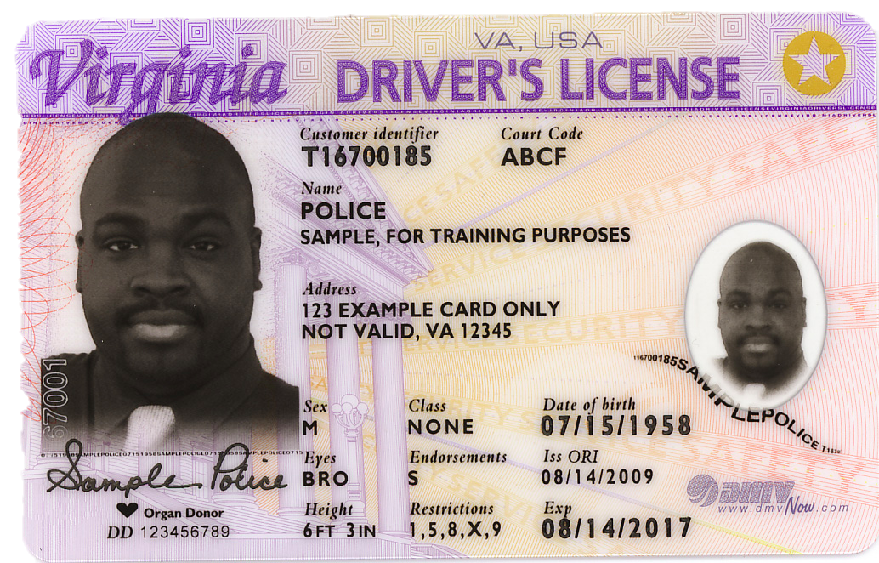
ANALYZE THE EXTENT TO WHICH GETTING YOUR DRIVER’S LICENSE IS A TURNING POINT IN YOUR LIFE.
OLD PATTERN
(PRE-TURNING POINT)
NEW PATTERN
(POST-TURNING POINT)
____________________________________________________________________________________________________________________________________________________________________________________________________________________________________________________________________
____________________________________________________________________________________________________________________________________________________________________________________________________________________________________________________________________
COMPARE THE PRE-DATE & THE POST DATE NOTING THE DEGREE TO WHICH THE MIDDLE POINT IS OR ISN’T A TURNING POINT.
DO NOT FOCUS ON CHANGES WITHIN A PERIOD (THAT’S CCOT)

Slide 19
ANALYZE THE EXTENT TO WHICH THE INDUSTRIAL REVOLUTION CAN BE CONSIDERED A TURNING POINT IN HISTORY.
OLD PATTERN
(PRE-TURNING POINT)
NEW PATTERN
(POST-TURNING POINT)
________________________________________________________________________________________________________________________
________________________________________________________________________________________________________________________
*THE DATE DOES NOT HAVE TO BE AN “AP PERIODIZATION DATE”
1. ______ 2. ______ 3. _______ 4. ______ 5. _______ 6. ______
1. ______ 2. ______ 3. _______ 4. ______ 5. _______ 6. ______

