Slide 2
Identify one way a hot dog can be considered a sandwich
Identify a SECOND way a hot dog can be considered a sandwich
Explain why a hot dog is NOT considered a sandwich
Notes:
🍐 This is a Pear Deck Text Slide
🍐 To edit the type of question, go back to the "Ask Students a Question" in the Pear Deck sidebar.

Slide 3
HOW TO
HOW TO
S.A.Q.
S.A.Q.

Slide 4
THE SECOND PART OF SECTION I OF THE AP EXAM ALSO INCLUDES THREE REQUIRED SHORT-ANSWER QUESTIONS.
SHORT-ANSWER QUESTION 1 IS REQUIRED AND INCLUDES A SECONDARY SOURCE STIMULUS. THE TOPIC OF THE QUESTION WILL INCLUDE HISTORICAL DEVELOPMENTS OR PROCESSES BETWEEN THE YEARS 1200 AND 2001.
SHORT-ANSWER QUESTION 2 IS REQUIRED AND INCLUDES A PRIMARY SOURCE STIMULUS. THE TOPIC OF THE QUESTION WILL INCLUDE HISTORICAL DEVELOPMENTS OR PROCESSES BETWEEN THE YEARS 1200 AND 2001.
STUDENTS MAY SELECT SHORT-ANSWER QUESTIONS 3 OR 4, NEITHER OF WHICH INCLUDES A STIMULUS.
SHORT-ANSWER QUESTION 3 WILL FOCUS ON HISTORICAL DEVELOPMENTS OR PROCESSES BETWEEN THE YEARS 1200 AND 1750.
SHORT-ANSWER QUESTION 4 WILL FOCUS ON HISTORICAL DEVELOPMENTS OR PROCESSES BETWEEN THE YEARS 1750 AND 2001. ALL FOUR HISTORICAL PERIODS ARE REPRESENTED AMONG THE FOUR SHORT-ANSWER QUESTIONS

Slide 5
4 QUESTIONS (YOU ANSWER 3)
3 PARTS TO EACH QUESTION (A, B, C).
THEY'LL GIVE YOU SOME STIMULUS (LIKE THE MULTIPLE CHOICE) OR JUST A REGULAR PROMPT AND 3 QUESTIONS ABOUT IT.
NO THESIS NEEDED.

Slide 6
TIMING:
TIMING:
3 QUESTIONS
x3 PARTS (a.b.c.)
9 THINGS TO DO
4:26 PER PART
4:26 PER PART

Slide 7
YOUR ENTIRE ANSWER MUST FIT IN THIS BOX

Slide 8
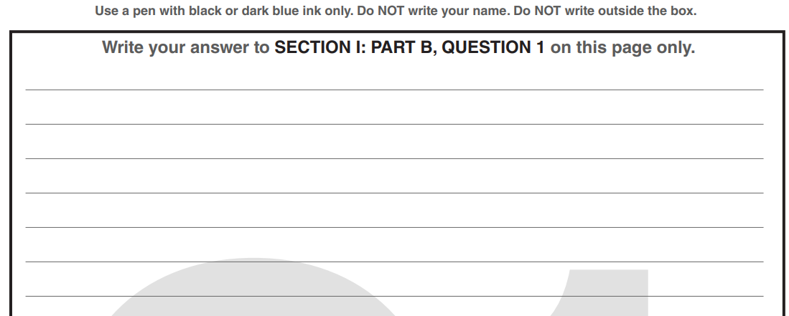
LABEL YOUR RESPONSES: A. B. C.
B.
C.

Slide 9
You MUST write in complete sentences (like this).
B.
Not like this.

Slide 10
Aim to write 2 - 4 sentences per letter (ABC). ‘Explain’ prompts will need more writing.
B.
C.

Slide 11
For each question they will only ask you to do one of two things: IDENTIFY or EXPLAIN.
B.
C.

Slide 12
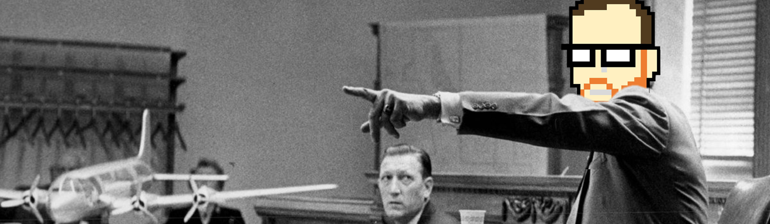
THEY’VE ONLY EVER ASKED IDENTIFY OR EXPLAIN. HERE’S HOW TO RESPOND TO:
IDENTIFY
IDENTIFY
INDICATE/PROVIDE INFORMATION ABOUT A SPECIFIC TOPIC
WITHOUT ELABORATION OR EXPLANATION
TREAT IT LIKE A COURTROOM
IS THE ANSWER HERE IN THE COURTROOM? CAN YOU IDENTIFY IT?

Slide 13
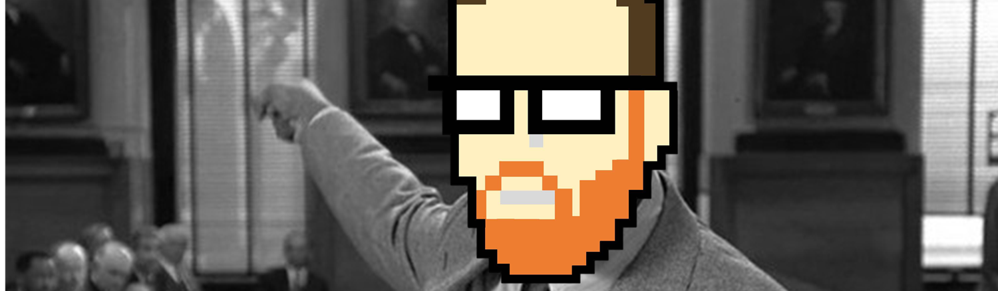
THEY’VE ONLY EVER ASKED IDENTIFY OR EXPLAIN. HERE’S HOW TO RESPOND TO:
EXPLAIN
EXPLAIN
PROVIDE INFORMATION AS TO HOW OR WHY SOMETHING OCCURS
TREAT IT LIKE A COURTROOM
CAN YOU EXPLAIN YOUR ANSWER TO ME LIKE I WAS AN 8-YEAR OLD?

Slide 15
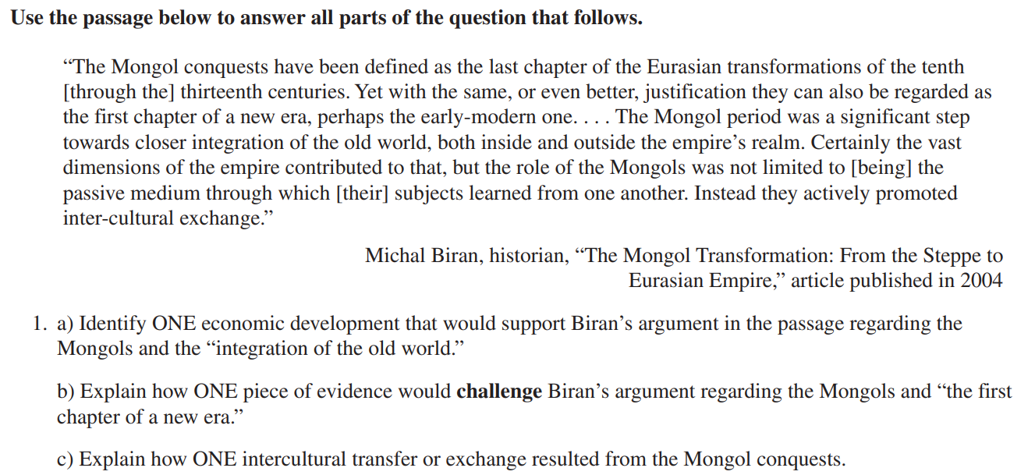
SKIP THE STIMULUS!!!
-Jump straight to the A.B.C.s
-Annotate (write on) the prompt
-Focus on what to look for in the prompt

Slide 17
IT’S STIMULUS TIME!
-You know what to look for…
-Annotate (write on) the stimulus
-Only SAQ 1 & 2 will have Stimuli

Slide 19
LABEL A… B… C… & GO!
-You’ve looked at ABC before…
-You’ve read/seen the stimuli…
-Label A. Write in complete sentences…
-Label B: Repeat. WRITE IN THE BOX!!!

Slide 20
Think of the acronym “AGE” when responding to a prompt:
Answer the question
Give an example
Explain your reasoning

Slide 21
Non-content Example
Explain one specific reason for La Porte High School’s implementation of student’s wearing an I.D. policy.
Explain one way implementing this policy is easy for La Porte High School
Explain one way implementing this policy is difficult for La Porte High School
La Porte High School implements a strict I.D. wearing policy in efforts to increase school safety (A). For example, other schools in the country such as Robb Elementary School in Uvalde, Texas and Stoneman Douglas High School in Parkland, Florida have endured tragic mass-violence inflicted by individuals who did not belong inside of the school building (G). Because of these events, La Porte High School hopes that implementing this I.D. wearing policy will allow staff to have a constant knowledge of those who are permitted to be inside of the building as an effort to keep students safe (E).

Slide 22
Non-content Examples
Identify one way that the Internet made quarantine from COVID-19 more enjoyable
Explain how the Internet worsened the COVID-19 pandemic
Identify and Explain one other time in History when a new innovation has dramatically changed common people’s quality of life
Other silly prompt examples:
Explain what is the best breakfast cereal in the United States
Explain which day of the week is the best
Explain one way freshmen year of high school differs from sophomore year

Slide 23
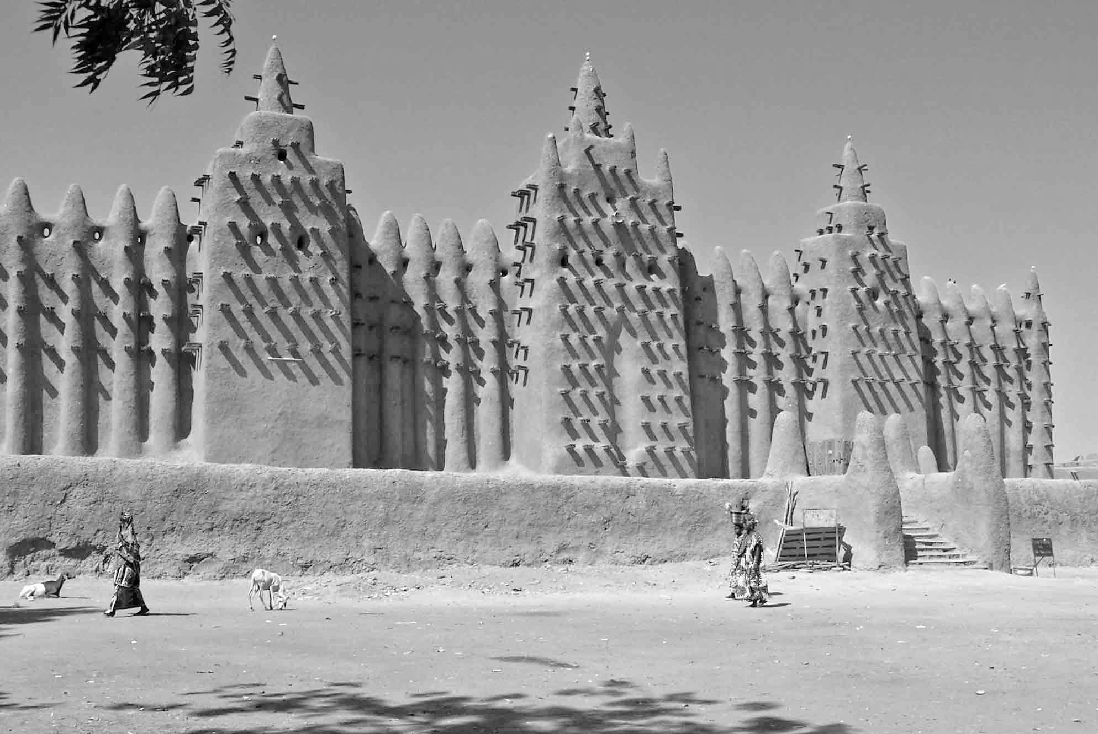
PRACTICE-PRACTICE-PRACTICE-PRACTICE
A. Identify ONE way in which African states or societies changed as a result of the spread of Islam in the period circa 1200 to 1450.
B. Explain how ONE specific African region was affected by the spread of Islam in the period circa 1200 to 1450.
C. Explain ONE way in which existing African religious or cultural traditions influenced the practice of Islam in Africa in the period 1200 to 1450.

Slide 24
PRACTICE-PRACTICE-PRACTICE-PRACTICE
A. Identify ONE way in which African states or societies changed as a result of the spread of Islam in the period circa 1200 to 1450.

Slide 25
PRACTICE-PRACTICE-PRACTICE-PRACTICE
B. Explain how ONE specific African region was affected by the spread of Islam in the period circa 1200 to 1450.

Slide 26
PRACTICE-PRACTICE-PRACTICE-PRACTICE
C. Explain ONE way in which existing African religious or cultural traditions influenced the practice of Islam in Africa in the period 1200 to 1450.

